Slide 1
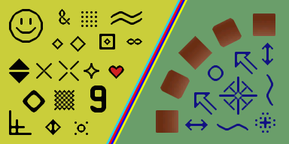
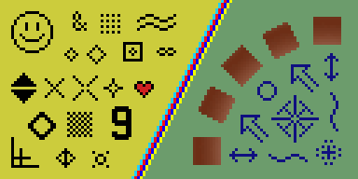
Image Resampling & Interpolation

Slide 2
Image Resampling & Interpolation
Reading: SZ Chapter 3.4-3.5

Slide 3
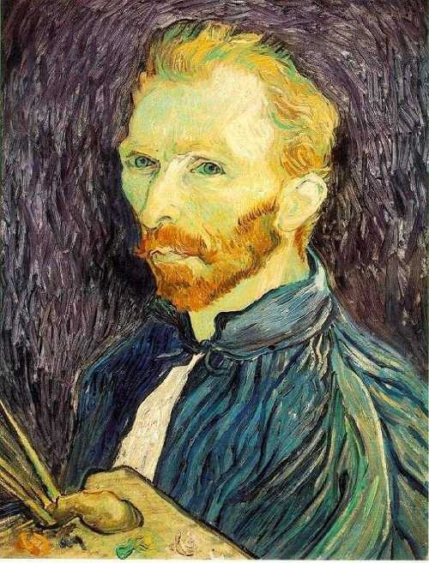
Image scaling
This image is too big to fit on the screen. How can we generate a half-sized version?
Source: S. Seitz

Slide 4

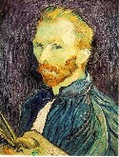

Image sub-sampling
1/8
1/4
Throw away every other row and column to create a 1/2 size image
- called image sub-sampling
Source: S. Seitz

Slide 5
Image sub-sampling
1/2
1/4 (2x zoom)
1/8 (4x zoom)
Why does this look so crufty?
Source: S. Seitz

Slide 6
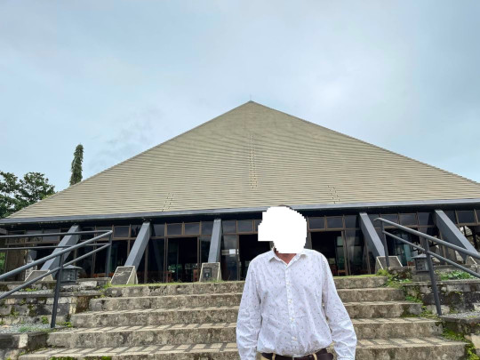
Image sub-sampling – another example

Slide 7
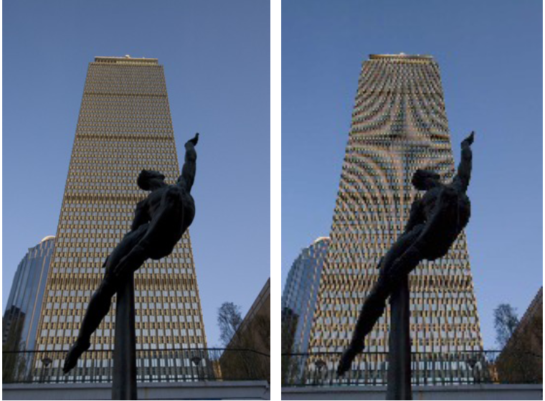
Image sub-sampling – another example
Source: F. Durand

Slide 8
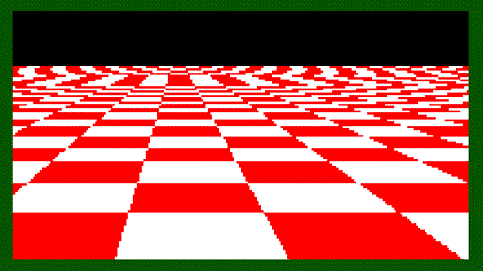
Even worse for synthetic images
Source: L. Zhang

Slide 9
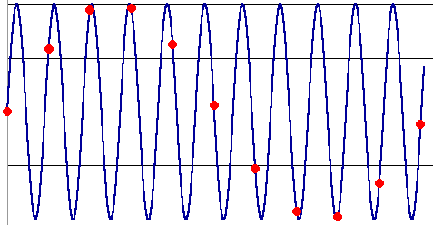
Aliasing
Occurs when your sampling rate is not high enough to capture the amount of detail in your image
Can give you the wrong signal/image—an alias
To do sampling right, need to understand the structure of your signal/image
Enter Monsieur Fourier…
“But what is the Fourier Transform? A visual introduction.” https://www.youtube.com/watch?v=spUNpyF58BY
To avoid aliasing:
sampling rate ≥ 2 * max frequency in the image
said another way: ≥ two samples per cycle
This minimum sampling rate is called the Nyquist rate
Source: L. Zhang

Slide 10
Wagon-wheel effect
video_20240118_103148.mp4
https://www.facebook.com/reel/339821715445217

Slide 11

Wagon-wheel effect
https://en.wikipedia.org/wiki/Wagon-wheel_effect

Slide 12
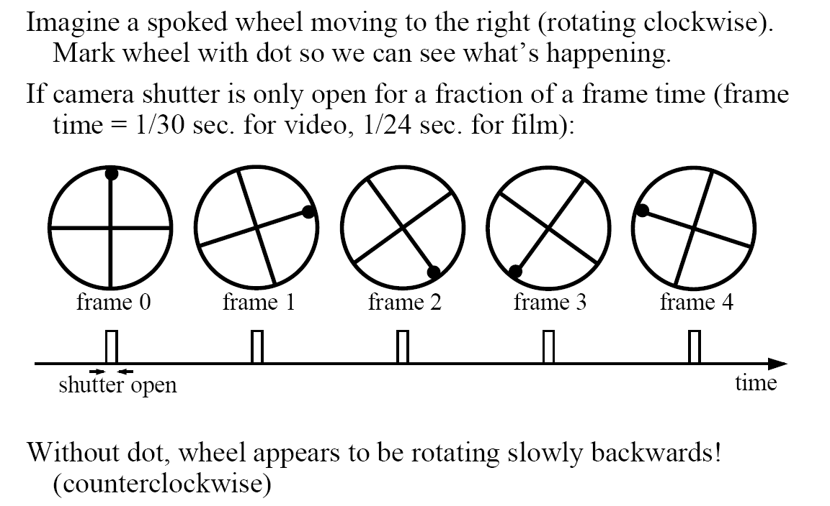
Wagon-wheel effect
(See http://www.michaelbach.de/ot/mot-wagonWheel/index.html)
Source: L. Zhang

Slide 13
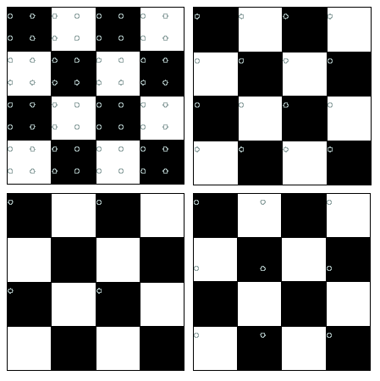
Nyquist limit – 2D example
Good sampling
Bad sampling

Slide 14
Aliasing
When downsampling by a factor of two
Original image has frequencies that are too high
How can we fix this?

Slide 15



Gaussian pre-filtering
G 1/8
G 1/4
Gaussian 1/2
Source: S. Seitz
Solution: filter the image, then subsample

Slide 16
Subsampling with Gaussian pre-filtering
Gaussian 1/2
G 1/4
G 1/8
Solution: filter the image, then subsample
Source: S. Seitz

Slide 17
Compare with...
1/2
1/4 (2x zoom)
1/8 (4x zoom)
Source: S. Seitz

Slide 18
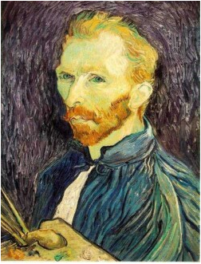





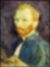
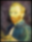
Gaussian pre-filtering
Solution: filter the image, then subsample
F₀
F₁
F₂
…
blur
subsample
blur
subsample
F₀ H
F₁ H
*
*

Slide 19
{
Gaussian pyramid
F₀
F₁
F₂
…
blur
subsample
blur
subsample
F₀ H
F₁ H
*
*

Slide 20
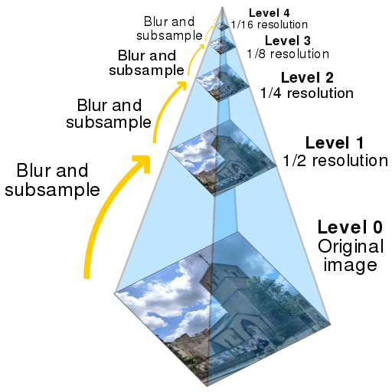

Slide 21
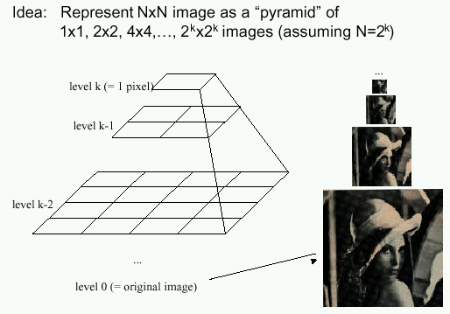
Gaussian pyramids [Burt and Adelson, 1983]
In computer graphics, a mip map [Williams, 1983]
A precursor to wavelet transform
Gaussian Pyramids have all sorts of applications in computer vision
Source: S. Seitz

Slide 22
Gaussian pyramids [Burt and Adelson, 1983]
How much space does a Gaussian pyramid take compared to the original image?
Source: S. Seitz

Slide 23
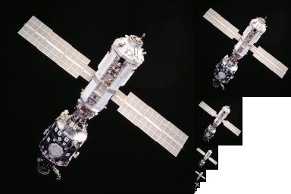
Gaussian pyramid
n x n = n²
n/2 x n/2 = n²/4
n/4 x n/4 = n²/16
n/8 x n/8 = n²/64
...

Slide 24
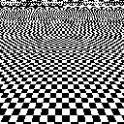
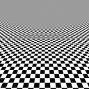
Back to the checkerboard
What should happen when you make the checkerboard smaller and smaller?
Image turns grey! (Average of black and white squares, because each pixel contains both.)
Naïve subsampling
Proper prefiltering
(“antialiasing”)

Slide 25
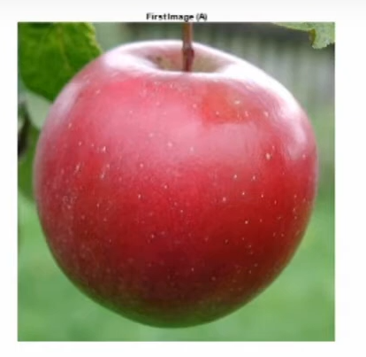
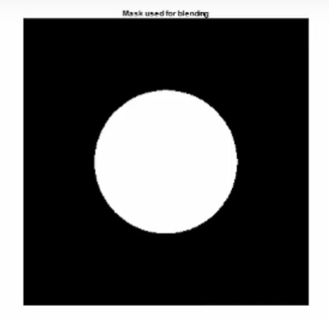
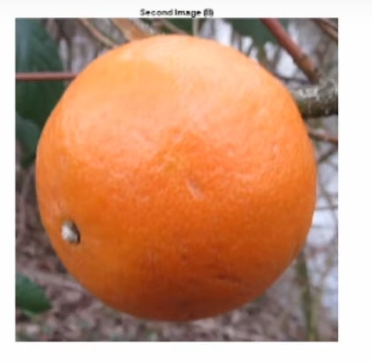
An aside: Image Blending

Slide 26
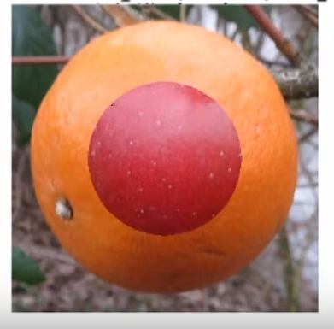
An aside: Image Blending

Slide 27
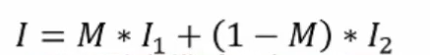
An aside: Image Blending

Slide 28
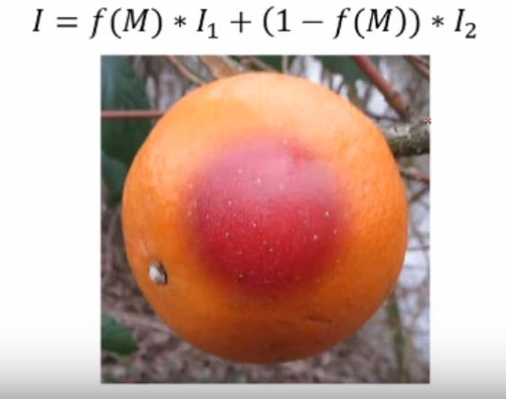
An aside: Image Blending

Slide 29

Upsampling
This image is too small for this screen:
How can we make it 10 times as big?
Simplest approach:
repeat each row
and column 10 times
(“Nearest neighbor
interpolation”)

Slide 30
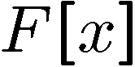

Image interpolation
d = 1 in this
example
1
2
3
4
5
Recall that a digital images is formed as follows:
It is a discrete point-sampling of a continuous function
If we could somehow reconstruct the original function, any new image could be generated, at any resolution and scale
Adapted from: S. Seitz

Slide 31
Image interpolation
d = 1 in this
example
1
2
3
4
5
Recall that a digital images is formed as follows:
It is a discrete point-sampling of a continuous function
If we could somehow reconstruct the original function, any new image could be generated, at any resolution and scale
Adapted from: S. Seitz

Slide 32


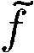
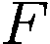
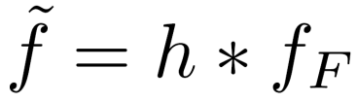
Image interpolation
1
d = 1 in this example
1
2
2.5
3
4
5
What if we don’t know ?
Guess an approximation:
Can be done in a principled way: filtering
Convert to a continuous function:
Reconstruct by convolution with a reconstruction filter, h
Adapted from: S. Seitz

Slide 33
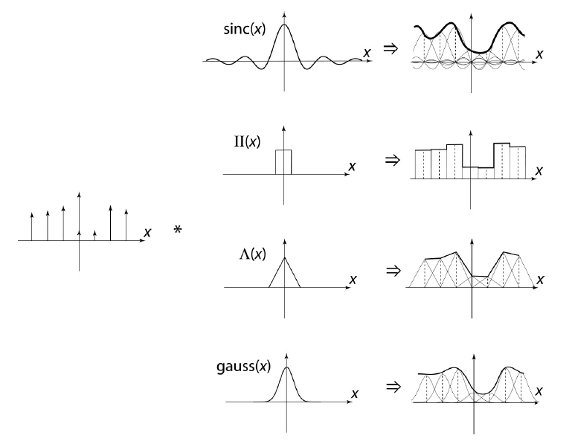
Image interpolation
“Ideal” reconstruction
Nearest-neighbor interpolation
Linear interpolation
Gaussian reconstruction
Source: B. Curless

Slide 34
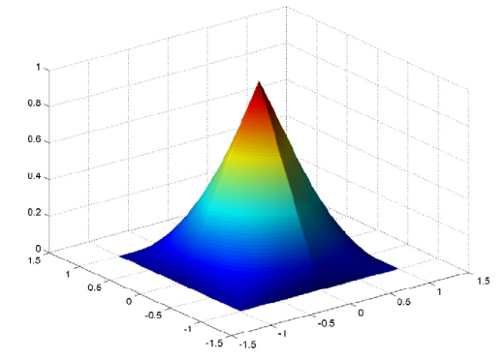
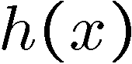
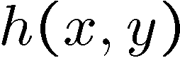
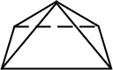
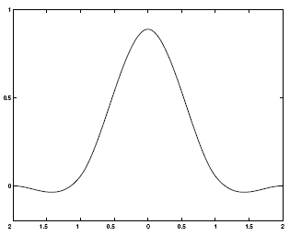
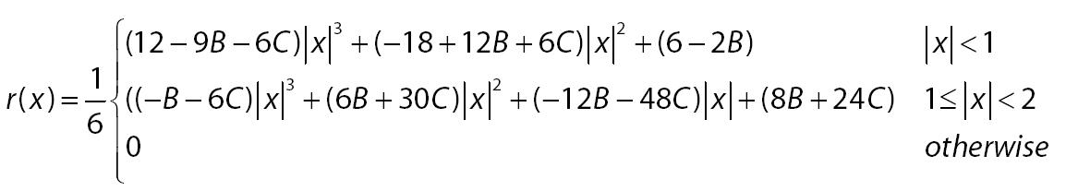
Reconstruction filters
What does the 2D version of this hat function look like?
performs
linear interpolation
(tent function) performs
bilinear interpolation
Often implemented without cross-correlation
E.g., http://en.wikipedia.org/wiki/Bilinear_interpolation
Better filters give better resampled images
Bicubic is common choice
Cubic reconstruction filter

Slide 35


Image interpolation
Original image: x 10
Nearest-neighbor interpolation
Bilinear interpolation
Bicubic interpolation

Slide 36
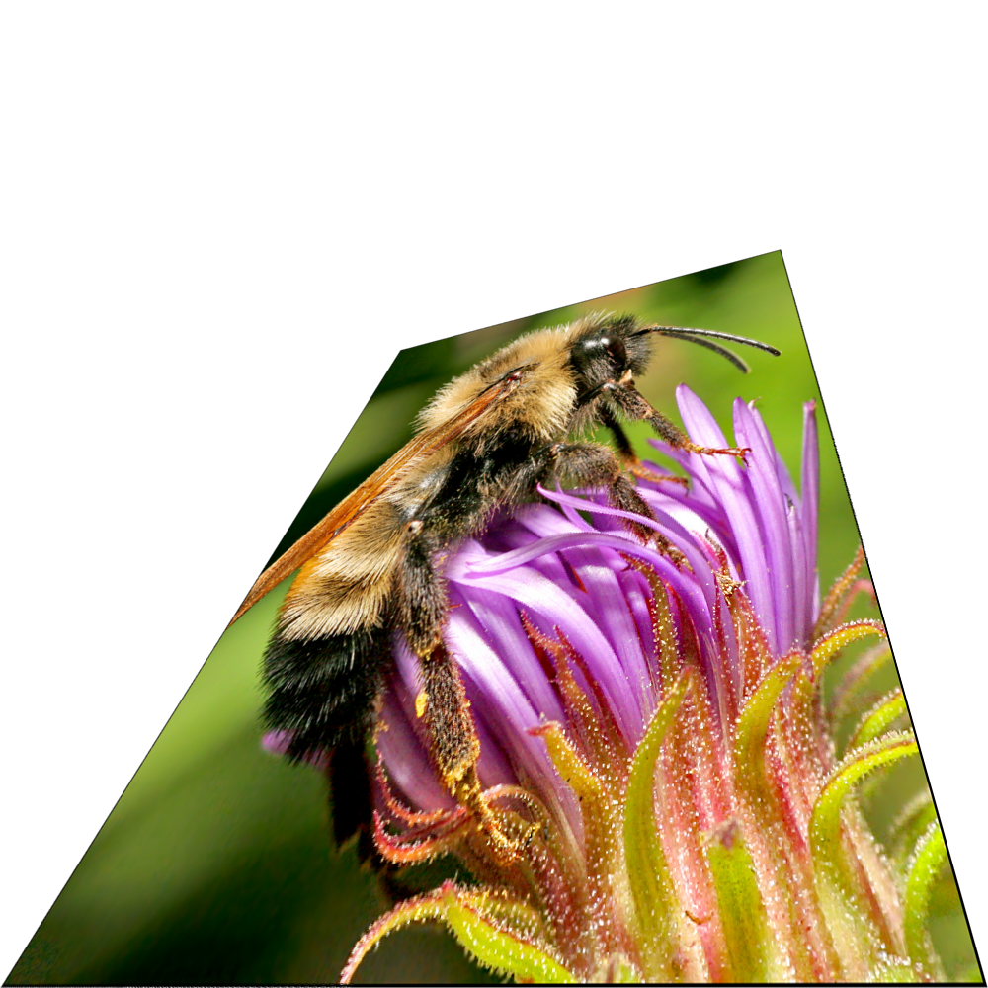
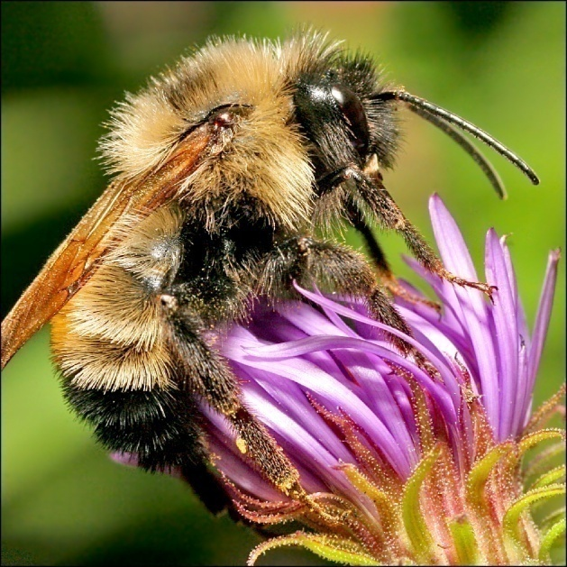
Image interpolation
Also used for resampling

Slide 37


Raster-to-vector graphics

Slide 38
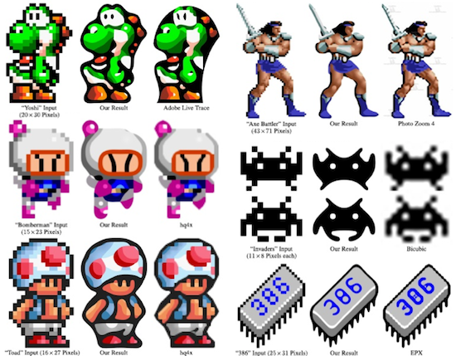
Depixelating Pixel Art

Slide 39
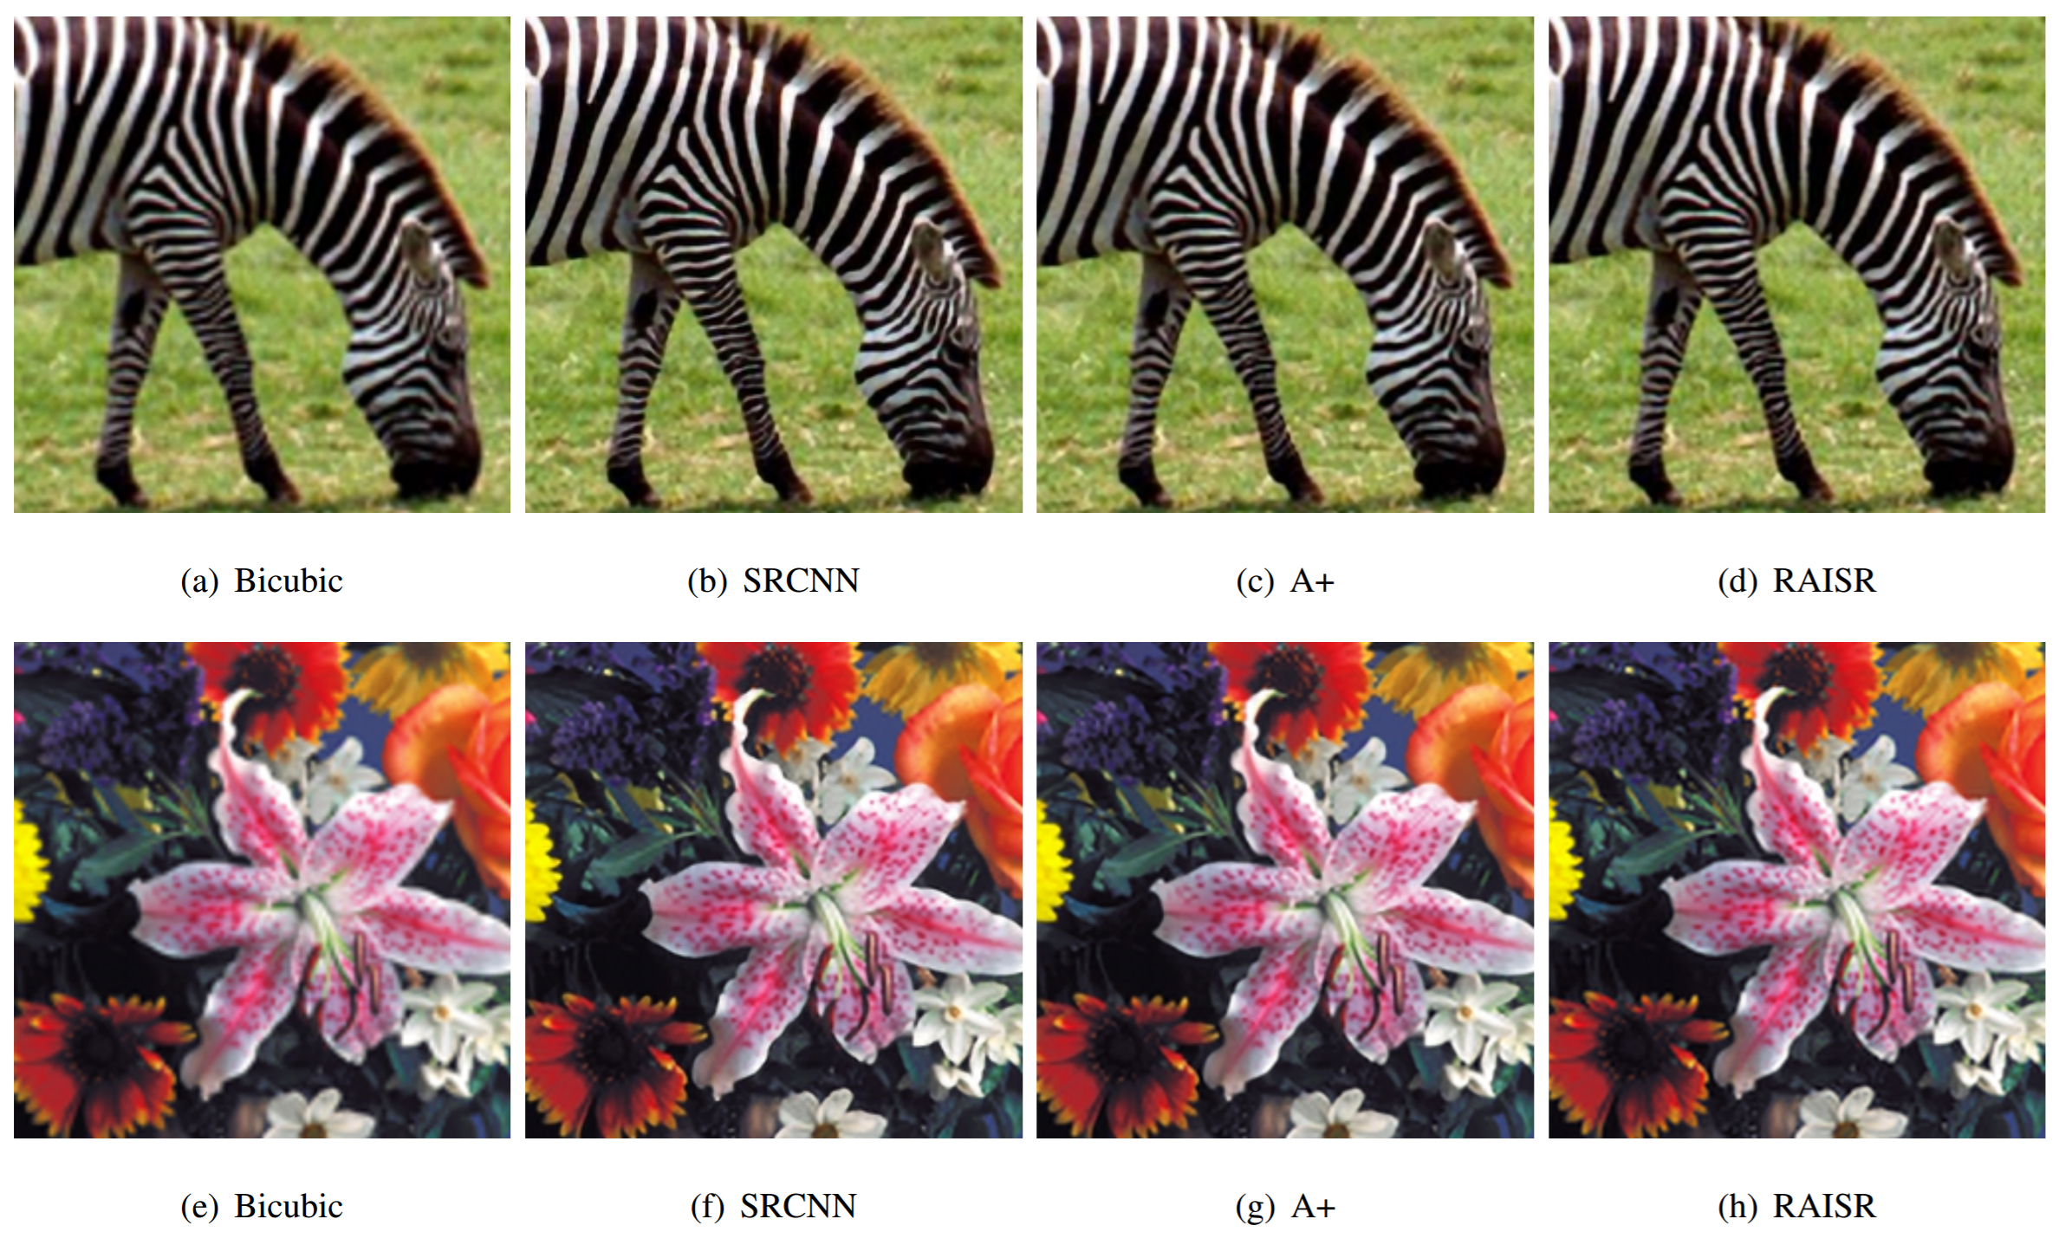
Modern methods
From Romano, et al: RAISR: Rapid and Accurate Image Super Resolution, https://arxiv.org/abs/1606.01299

Slide 40
Super-resolution with multiple images
Can do better upsampling if you have multiple images of the scene taken with small (subpixel) shifts
Some cellphone cameras (like the Google Pixel line) capture a burst of photos
Can we use that burst for upsampling?

Slide 41
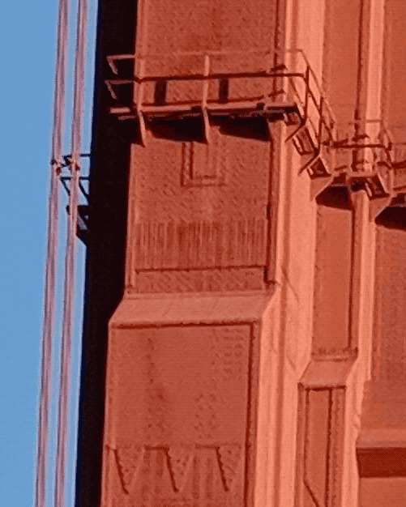
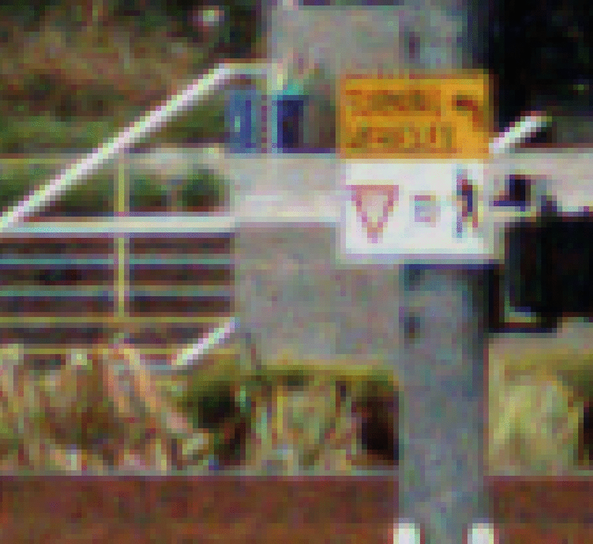
Google Pixel 3 Super Res Zoom
Effect of hand tremor as seen in a cropped burst of photos, after global alignment
Example photo with and without super res zoom (smart burst align and merge)
https://ai.googleblog.com/2018/10/see-better-and-further-with-super-res.html

Slide 42
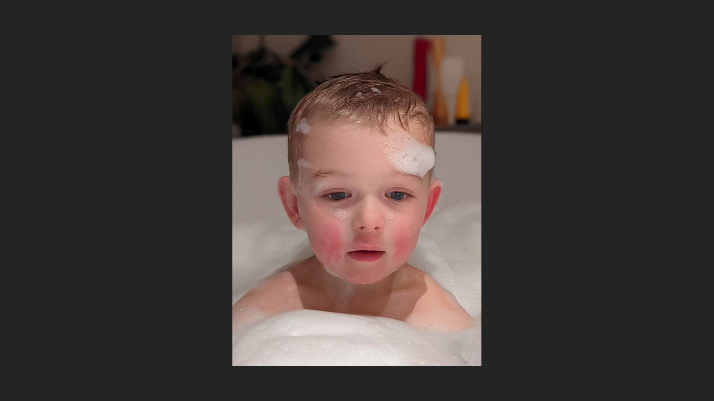
Large Motion Frame Interpolation
https://blog.research.google/2022/10/large-motion-frame-interpolation.html

